Slide 1
Agenda
GitHub Actions
What is GitHub Actions?​
GitHub Actions Features ​
GitHub Actions Architecture​
GitHub Actions Pipeline
Creating and Managing Workflows
Marketplace & Reusable Workflows
Security and Best Practices

Slide 2
What is GitHub Actions?​

Slide 3

What is GitHub Actions?​
GitHub Actions automates tasks like testing and deployment.
Workflows are defined using simple YAML files.
Supports running jobs on Linux, Windows, and macOS.
Offers built-in and community-contributed actions for automation.

Slide 4
Why Use GitHub Actions?​
Fully integrated with GitHub, so no need for external tools.
Easy to configure using simple YAML files inside your repository.
Automates workflows for all stages such as build, test, and deploy.
Supports many events and triggers to start workflows automatically.

Slide 5
Use Cases of GitHub Actions​
Automatically run tests on every pull request.
Deploy applications to cloud platforms (Azure, AWS, etc.).
Build and publish Docker images.
Automate issue and PR management.

Slide 6
GitHub Actions Features

Slide 7
GitHub Actions Features​
Multiple Triggers: Push, PR, issue, cron, release, and more.
Job Matrix: Test across multiple operating systems or versions.
Secrets & Env Variables: Store sensitive data securely.
Action Marketplace: Use and share prebuilt actions.
Workflow Automation: Easily build, test, and deploy projects.

Slide 8
Custom & Reusable Actions​
Create custom actions using JavaScript or Docker.
Reuse actions across multiple repositories.
Reduces code duplication in workflows.
Improves modularity and maintainability.

Slide 9
GitHub Actions Architecture​

Slide 10
GitHub Actions Architecture
Workflow: Main automation file defined in .github/workflows.
Job: A unit of work that runs on a runner.
Step: Each command or action within a job.
Action: Reusable code that performs a specific task.
Runner: Machine that runs the job (hosted or self-hosted).

Slide 11
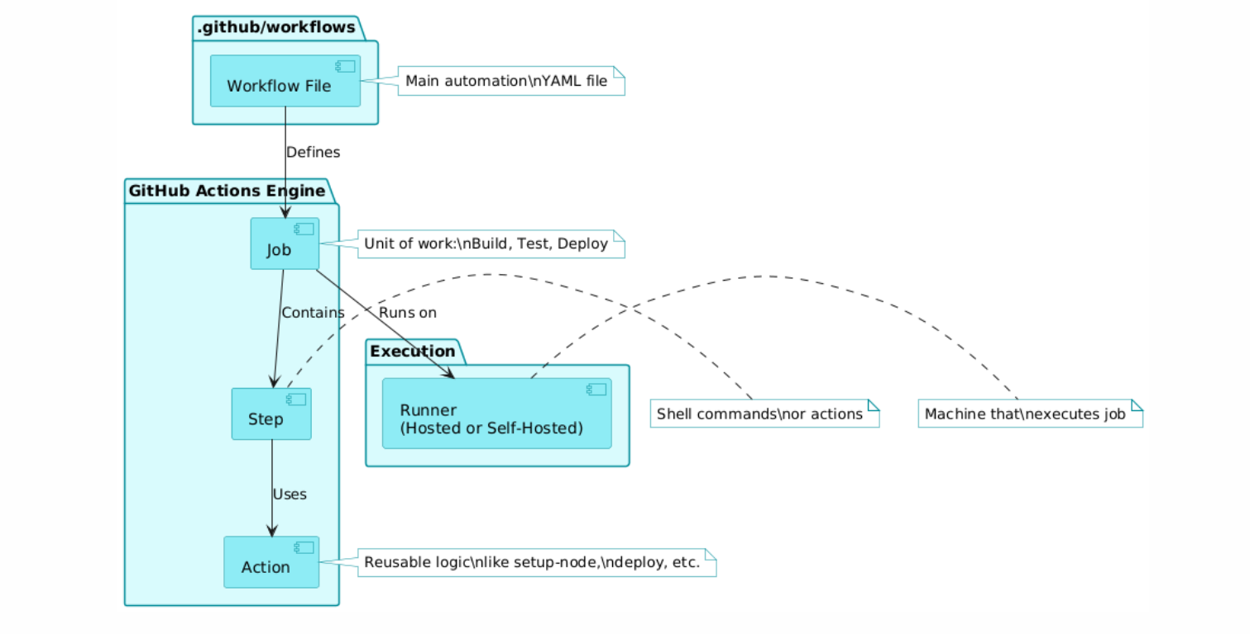
Lambda Functions

Slide 12
GitHub Actions Pipeline

Slide 13
GitHub Actions Pipeline
Pipelines are defined as workflows using YAML syntax.
Each workflow can have multiple jobs and steps.
Jobs can run in parallel or sequentially.
Use conditions and environments for flexibility.
Great for building, testing, and deploying automatically.

Slide 14
Pipeline – CI/CD Example
A pipeline is a YAML workflow file in .github/workflows/.
It defines steps for building, testing, and deploying code.
Triggers can be push, pull request, or scheduled events.
Example: A basic CI workflow for Node.js testing.

Slide 15
Pipeline Features & Flow
Jobs can run in sequence or in parallel using needs.
Supports conditions, matrix strategy, and environments.
Steps run inside a job on a runner (GitHub-hosted or self-hosted).
Workflow starts on events like code push or PR.

Slide 16
Multi-Job Pipeline Example
Matrix builds allow testing on multiple OS/platforms.
Jobs use strategy.matrix to define combinations.
Each matrix run executes independently.
Helps in cross-platform testing (e.g., Ubuntu, Windows).

Slide 17
Monitoring & Debugging Pipelines
GitHub shows real-time logs during pipeline runs.
You can view success, failure, and step-by-step output.
Use ::debug, ::error, and ::warning for custom logs.
Rerun failed workflows directly from the Actions tab.

Slide 18
Creating and Managing Workflows

Slide 19
Creating and Managing Workflows
Workflows are defined using YAML files inside the .github/workflows folder.
Each workflow contains jobs, and each job runs a series of steps.
Workflows are triggered by events like push, pull request, or schedule.
You can manage workflows from the GitHub Actions tab in your repository.

Slide 20
Workflow Structure and Execution
Workflow starts with the name and on (triggering event) keywords.
Jobs run on specific environments defined by runs-on.
Each job contains steps like run commands or reusable uses actions.
Jobs can run in parallel or sequentially using the needs keyword.

Slide 21
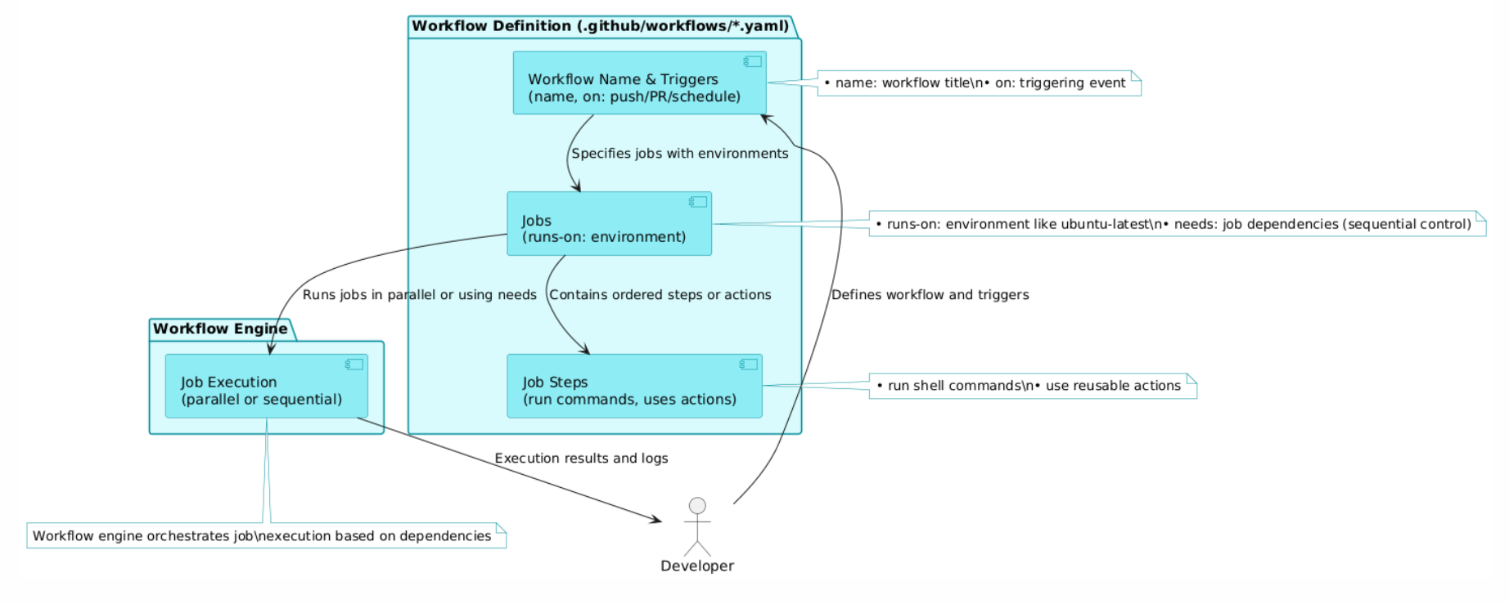
Workflow Structure and Execution

Slide 22
Marketplace & Reusable Workflows

Slide 23
Marketplace & Reusable Workflows
GitHub Marketplace offers thousands of ready-to-use actions.
Use uses: to include marketplace actions in your workflow.
Reusable workflows help share logic across multiple repos.
Call reusable workflows using the workflow_call trigger.

Slide 24
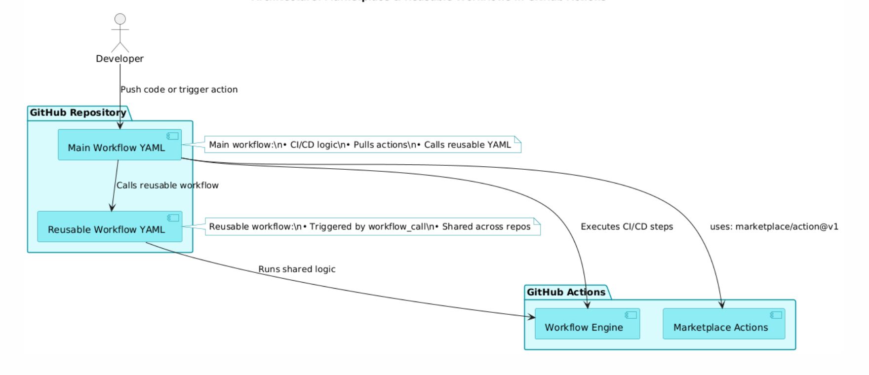
Workflow Structure and Execution

Slide 25
Security and Best Practices

Slide 26
Security and Best Practices
Use secrets to store sensitive data like API keys and tokens.
Always pin actions to a specific version to avoid unwanted updates.
Avoid hardcoding credentials or critical values in workflows.
Review third-party actions before using them from Marketplace.

